Slide 1
Experiment – 1
PRN : 25070521165
1.1.5 Student Pass or Fail status
Algorithm
STEP 1 : Start
STEP 2 : Input marks
STEP 3 : Check condition
If marks ≥ 40
Print "Pass"
Else
Print "Fail"
STEP 4 : Stop
Flowchart
Start
Input marks
If marks >= 40
Yes
No
Print “Pass”
Print “Fail”
Stop

Slide 2
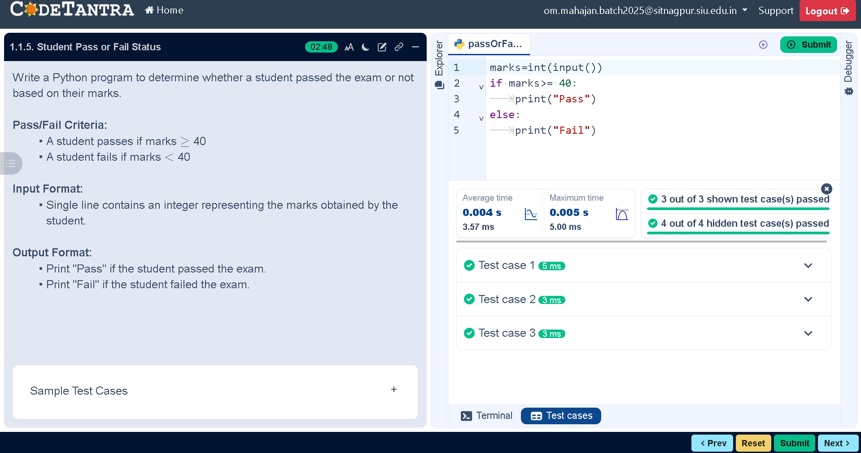
Code
PRN : 25070521165
marks=int(input())
if marks>= 40:
print("Pass")
else:
print("Fail")
Execution

